Slide 1

Hey

Slide 2
W
e
Are

Slide 3
N
ot

Slide 4
Seperable
Team

Slide 5


Slide 6


Slide 7


Slide 8


Slide 9
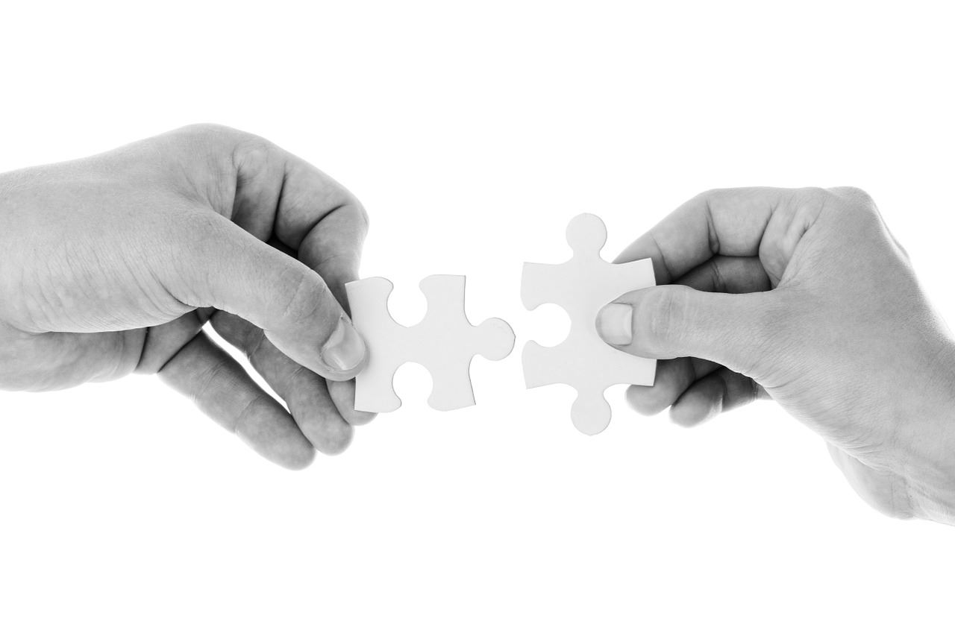

Slide 10
And
“
More
”

Slide 11
?

Slide 12
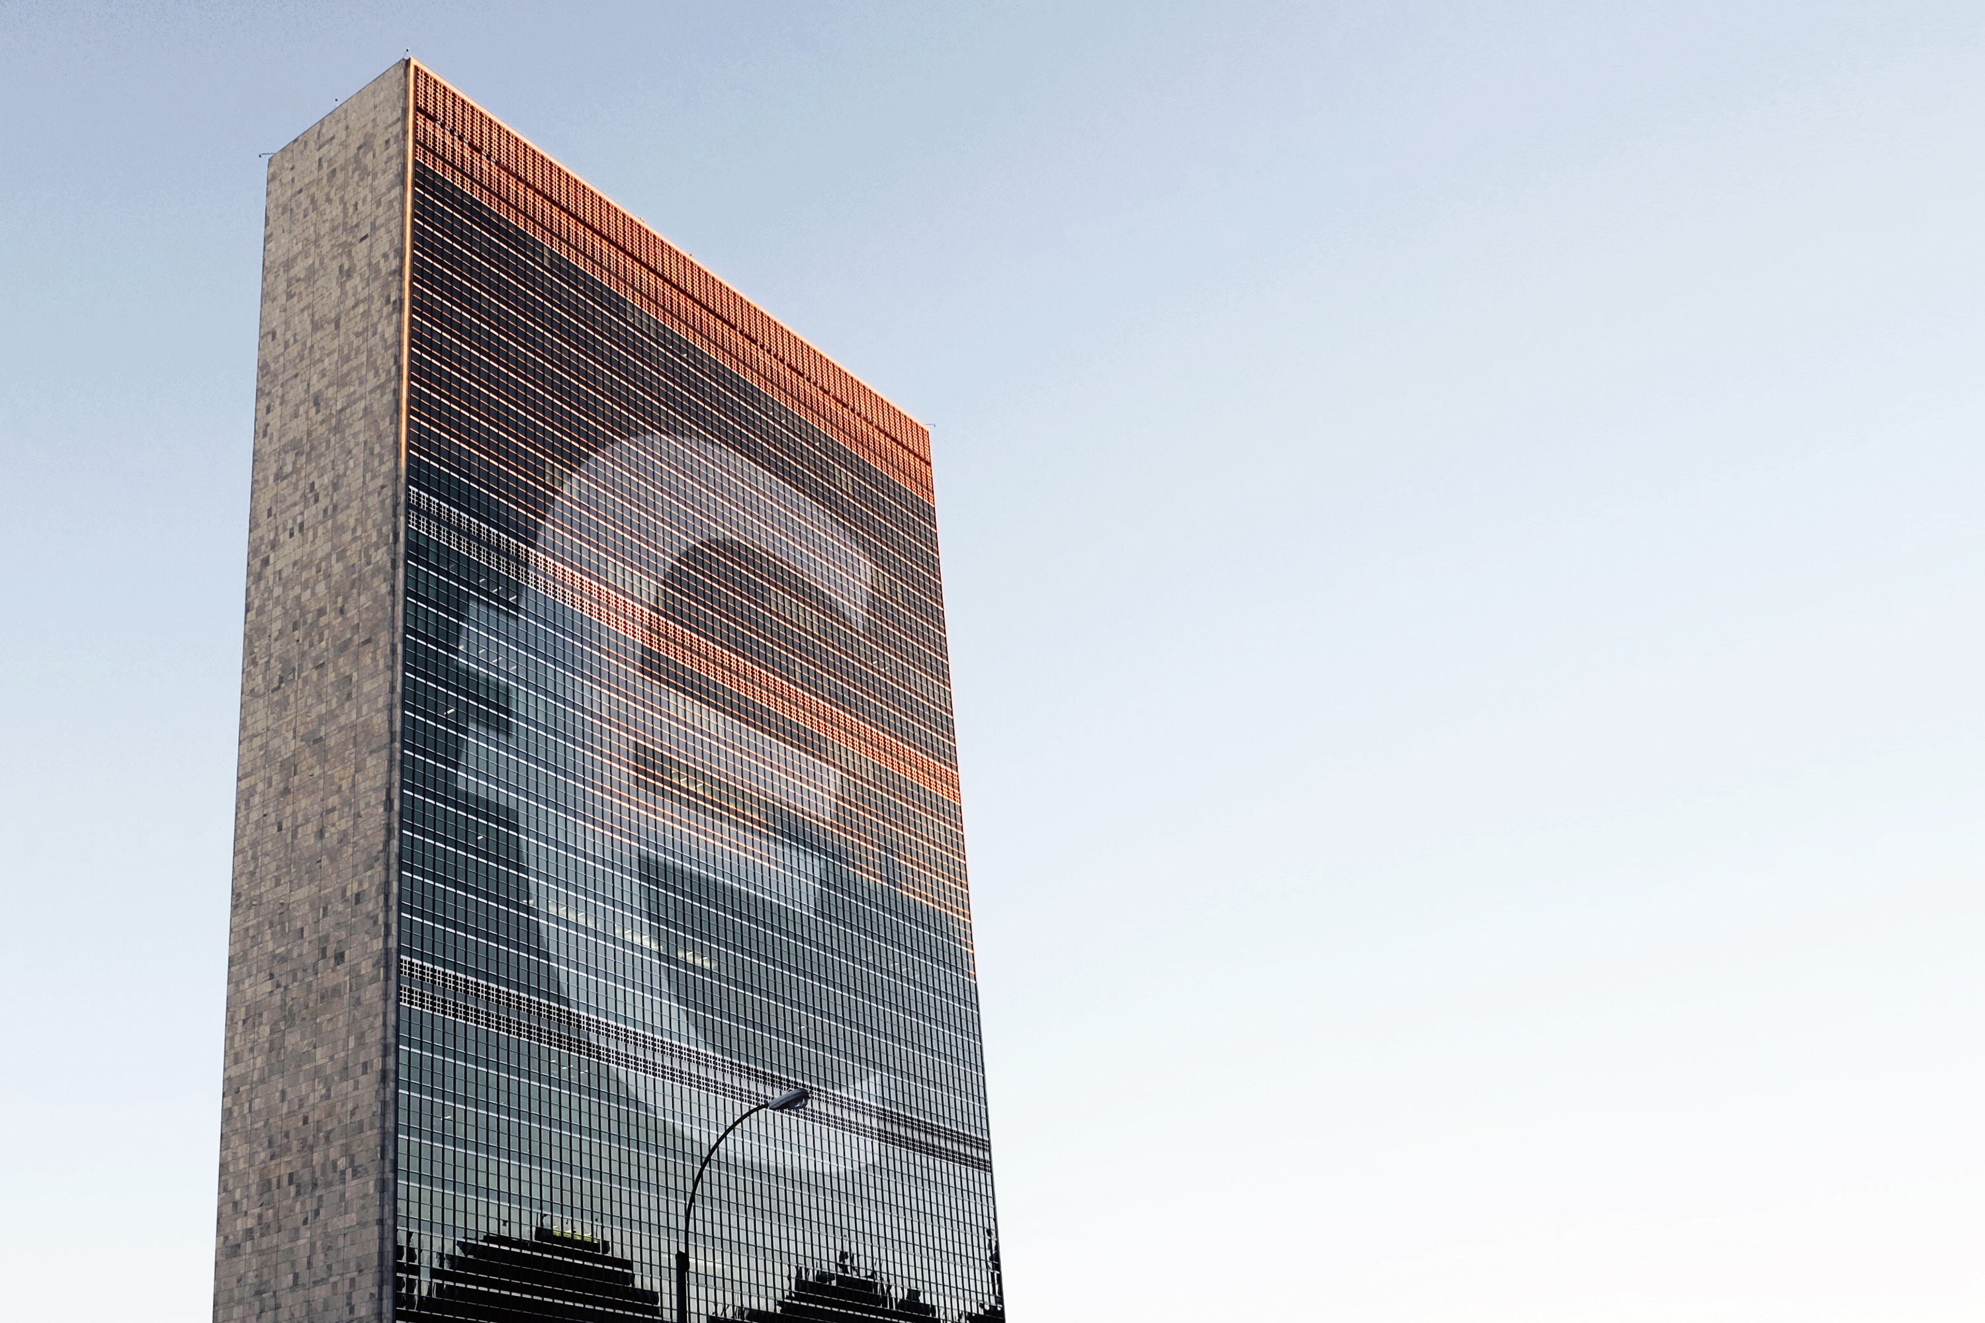

Slide 13
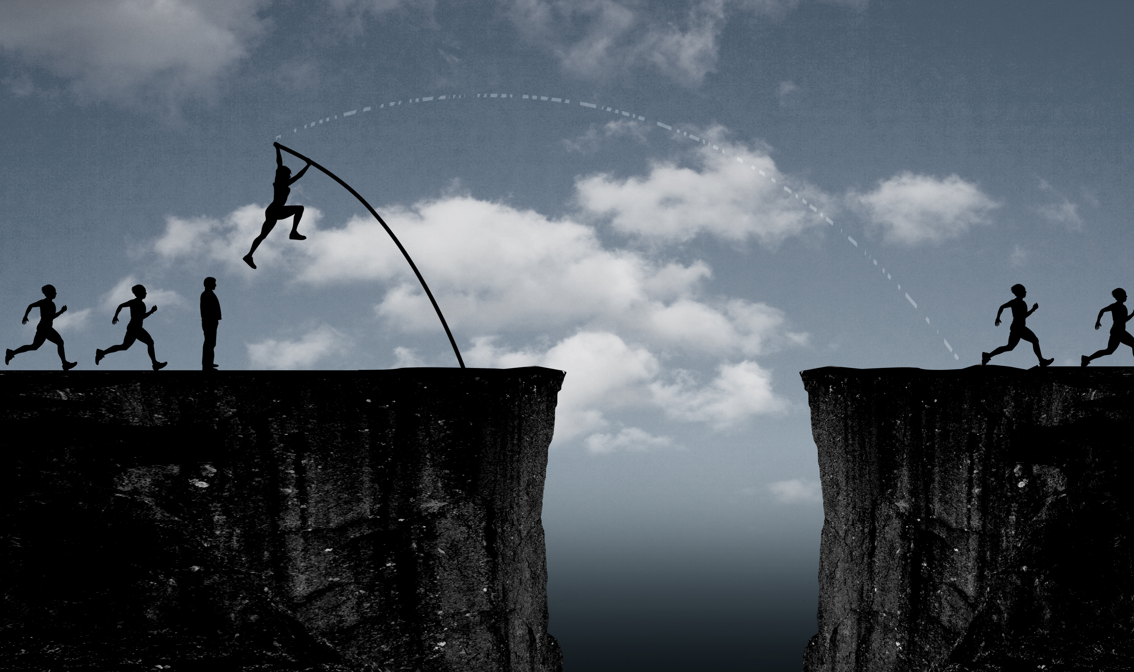

Slide 14
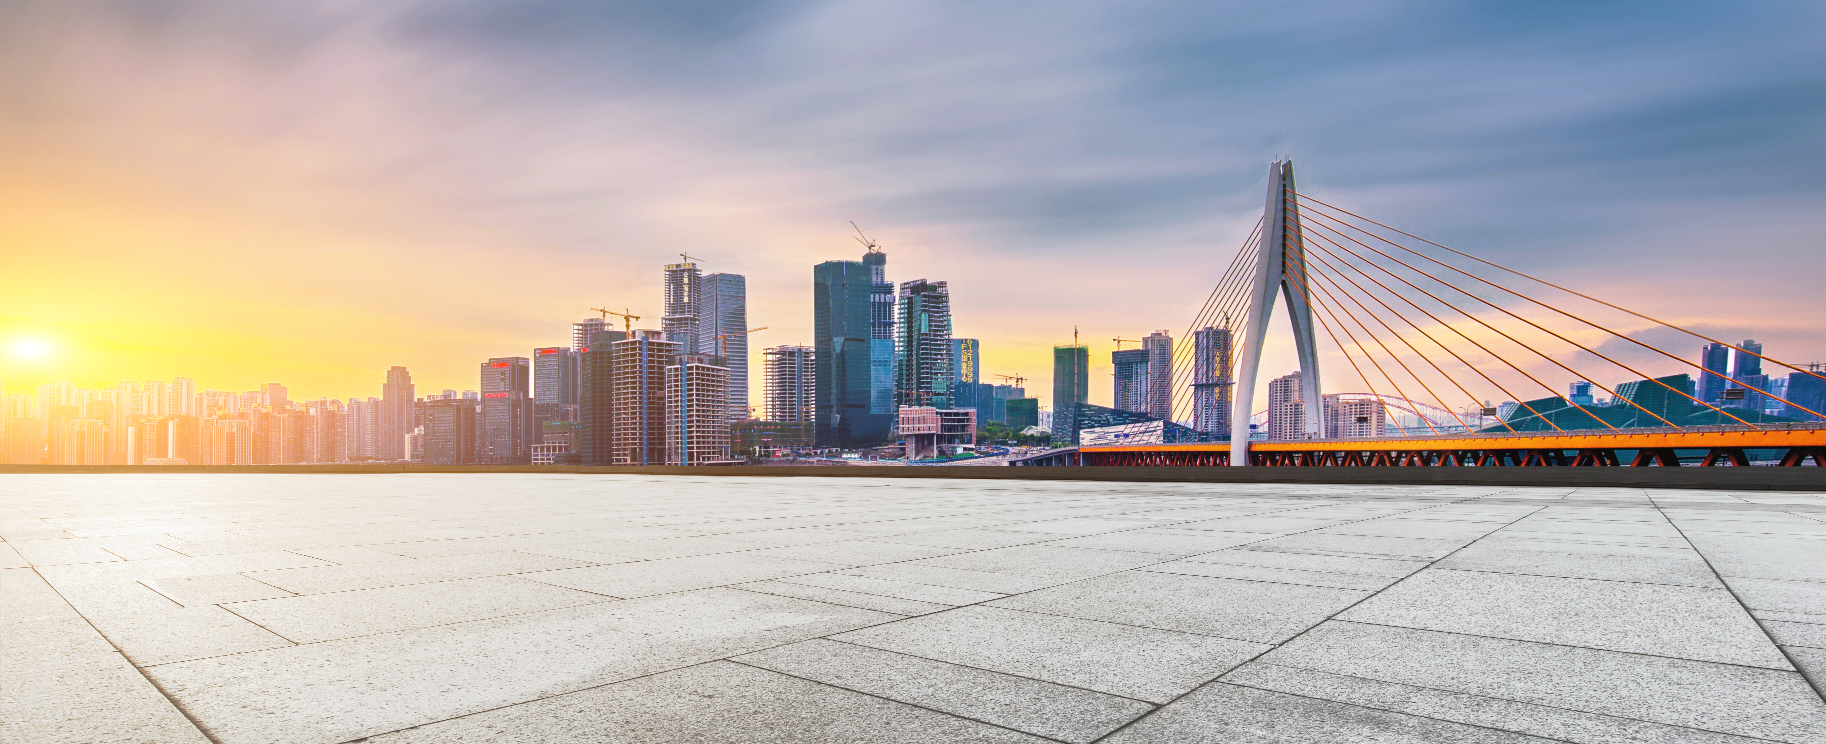
SURE

Slide 15
AND

Slide 16
WE

Slide 17
HAVE

Slide 18
THE

Slide 19
BEST

Slide 20
HE

Slide 21
AND

Slide 22
SHE

Slide 23
Although
Meeting
Conflict

Slide 24
To
Overcome
It

Slide 25
Forever
Teammate

Slide 26
we
are
伐木累
(Family)

Slide 27

Group 24
The stars, Our destination

Slide 28
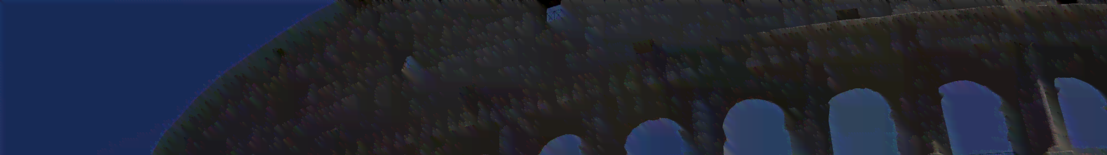
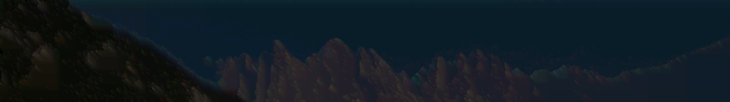
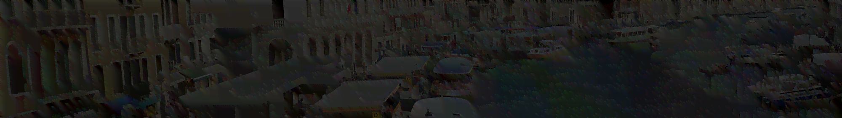
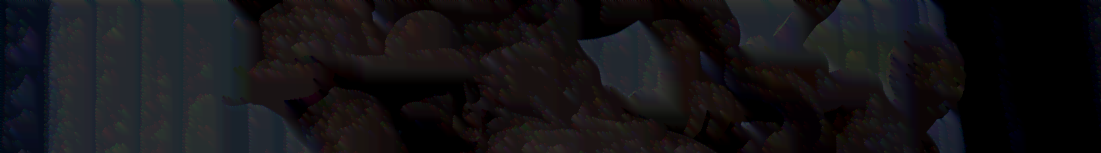
1
PART
ONE
2
PART
TWO
3
PART
THREE
4
PART
FOUR

Slide 29
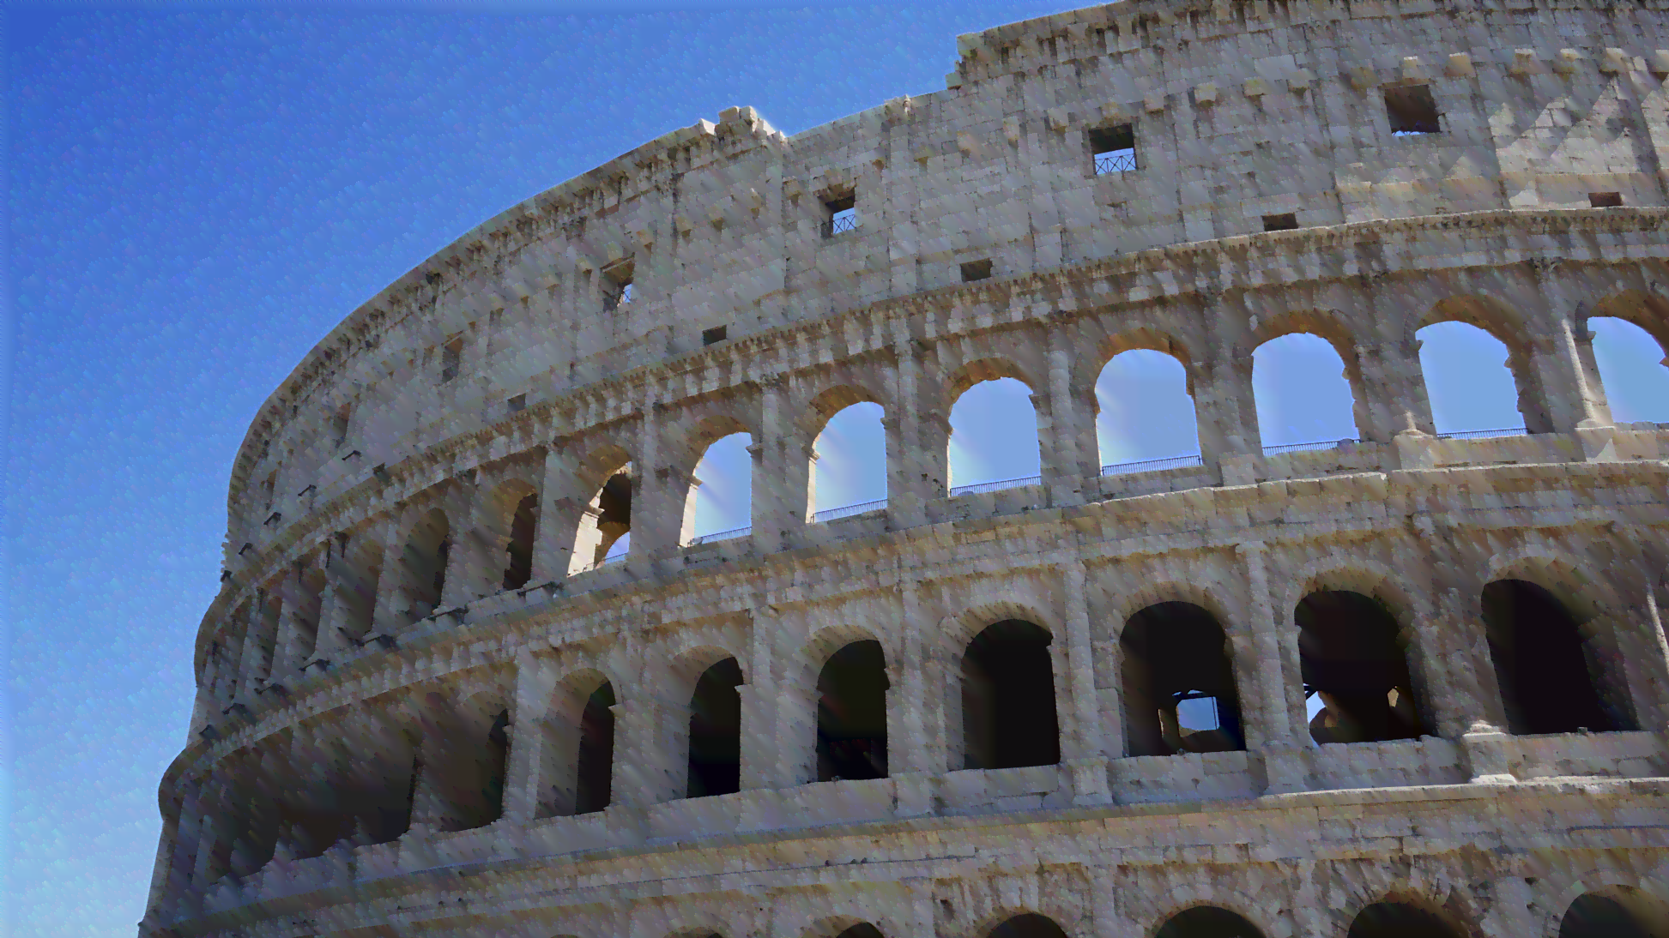
1
OUR
TEEM

Slide 30


Group
Twenty-Four

Slide 31
Conflict In Our job
Different idea about design?
Same working conflict?
Complex Code
Different Culture
Keeping the connect after school

Slide 32
2
2
WHY MAKING THIS GAME?

Slide 33
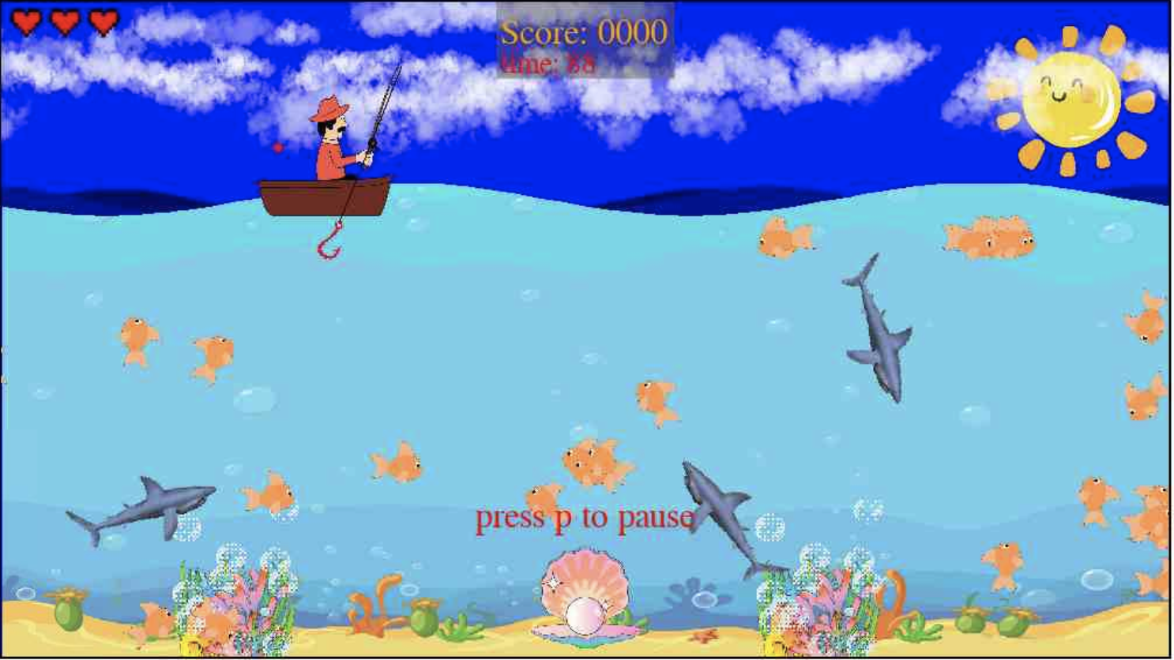
Original Intention
2
Human and Nature
Gift of Nature
Punishment of Nature

Slide 34
3
3
INTRODUCE

Slide 35
Basic Rule
You need to catch enough the fish to get enough mark (every fish 10 mark) then you will enter into next levels
Avoiding the Shark, they will eat you!
Remember you only have three life
Group
Twenty-Four

Slide 36
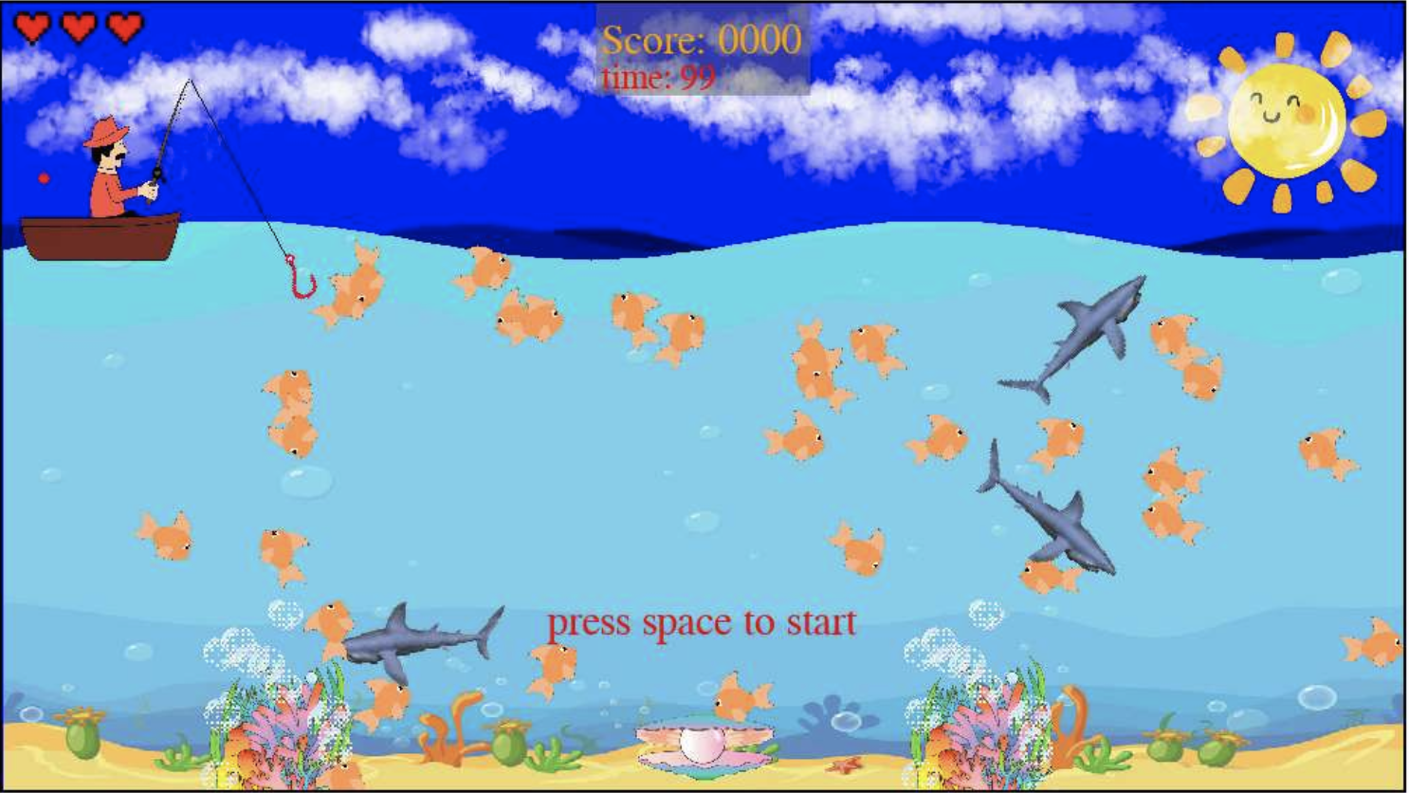



The Life
Fish
Group
Twenty-Four
Shark

Slide 37
Time and Score Board
Group
Twenty-Four

Slide 38
Key P Pause
Key A Left
Key D Right
Key S Release Hook
Game Over
Key Space Restart
Start of the Game
Key Space to start
Group
Twenty-Four

Slide 39
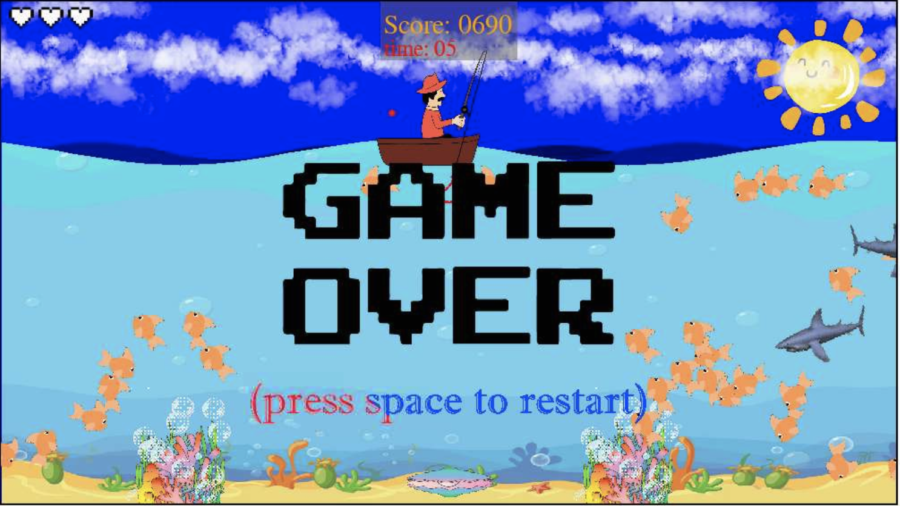
Group
Twenty-Four

Slide 40
4
4
About Our Code

Slide 41
The Structure of Our Code

Slide 42
Fish
Player
Background
Rod
Four Main Parts
Group
Twenty-Four

Slide 43
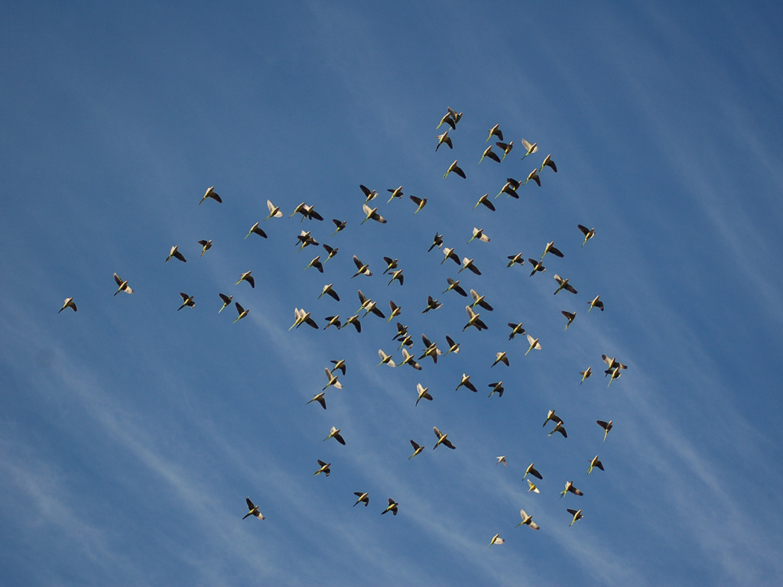
Fish
In the Fish.py, we have used the Boids Algorithm to simulate the real school of fish swimming as possible as restoring the real underwater world.
Group
Twenty-Four

Slide 44
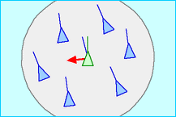
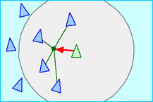
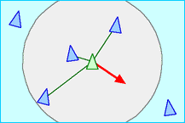
Fish
Alignment
Cohesion
Separation
Group
Twenty-Four

Slide 45
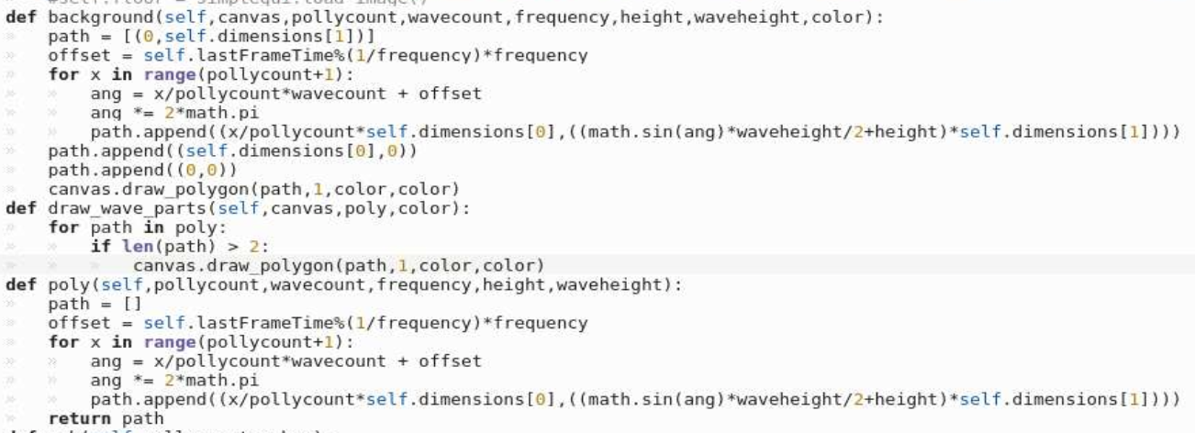
Background
For making the wave of the sea, We have used the canvas.draw-polygon method and because there are lots of waves with different speeds and direction so we need a list to save the all position of waves.
For making all the background more beautiful and dynamic, we have created a sprite-sheet class to iterate spirite-sheet.
And then, in the background.py has used too many the function of canvas.draw-image to input many pictures.
Group
Twenty-Four

Slide 46
Group
Twenty-Four

Slide 47
Group
Twenty-Four

Slide 48
Group
Twenty-Four

Slide 49
Group
Twenty-Four

